Slide 1



How PDS & HPE are Helping Schools Empower the Next Generation of Graduates
Cassandra Anderson – Systems Administrator
School District of Janesville
Heikki Heikkinen - Systems Engineer
Middleton-Cross Plains Area School District

Slide 2
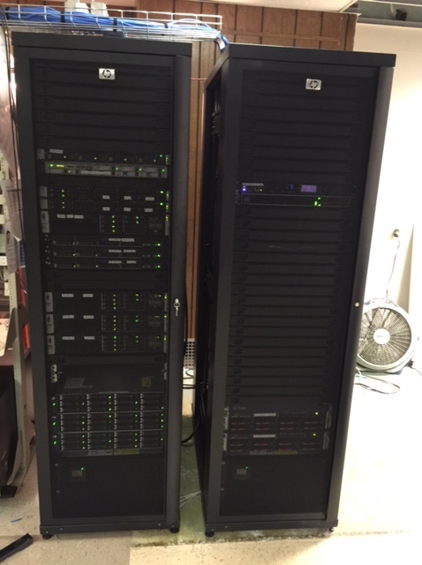
SDJ started with…
Issues/Struggles
Countless performance Issues
  Running on legacy hardware
  Reboots took 20 minutes
  Backups & restores took up to a few hours
  Consistent down-time and service disruptions
Being in a constant state of reaction

Slide 3
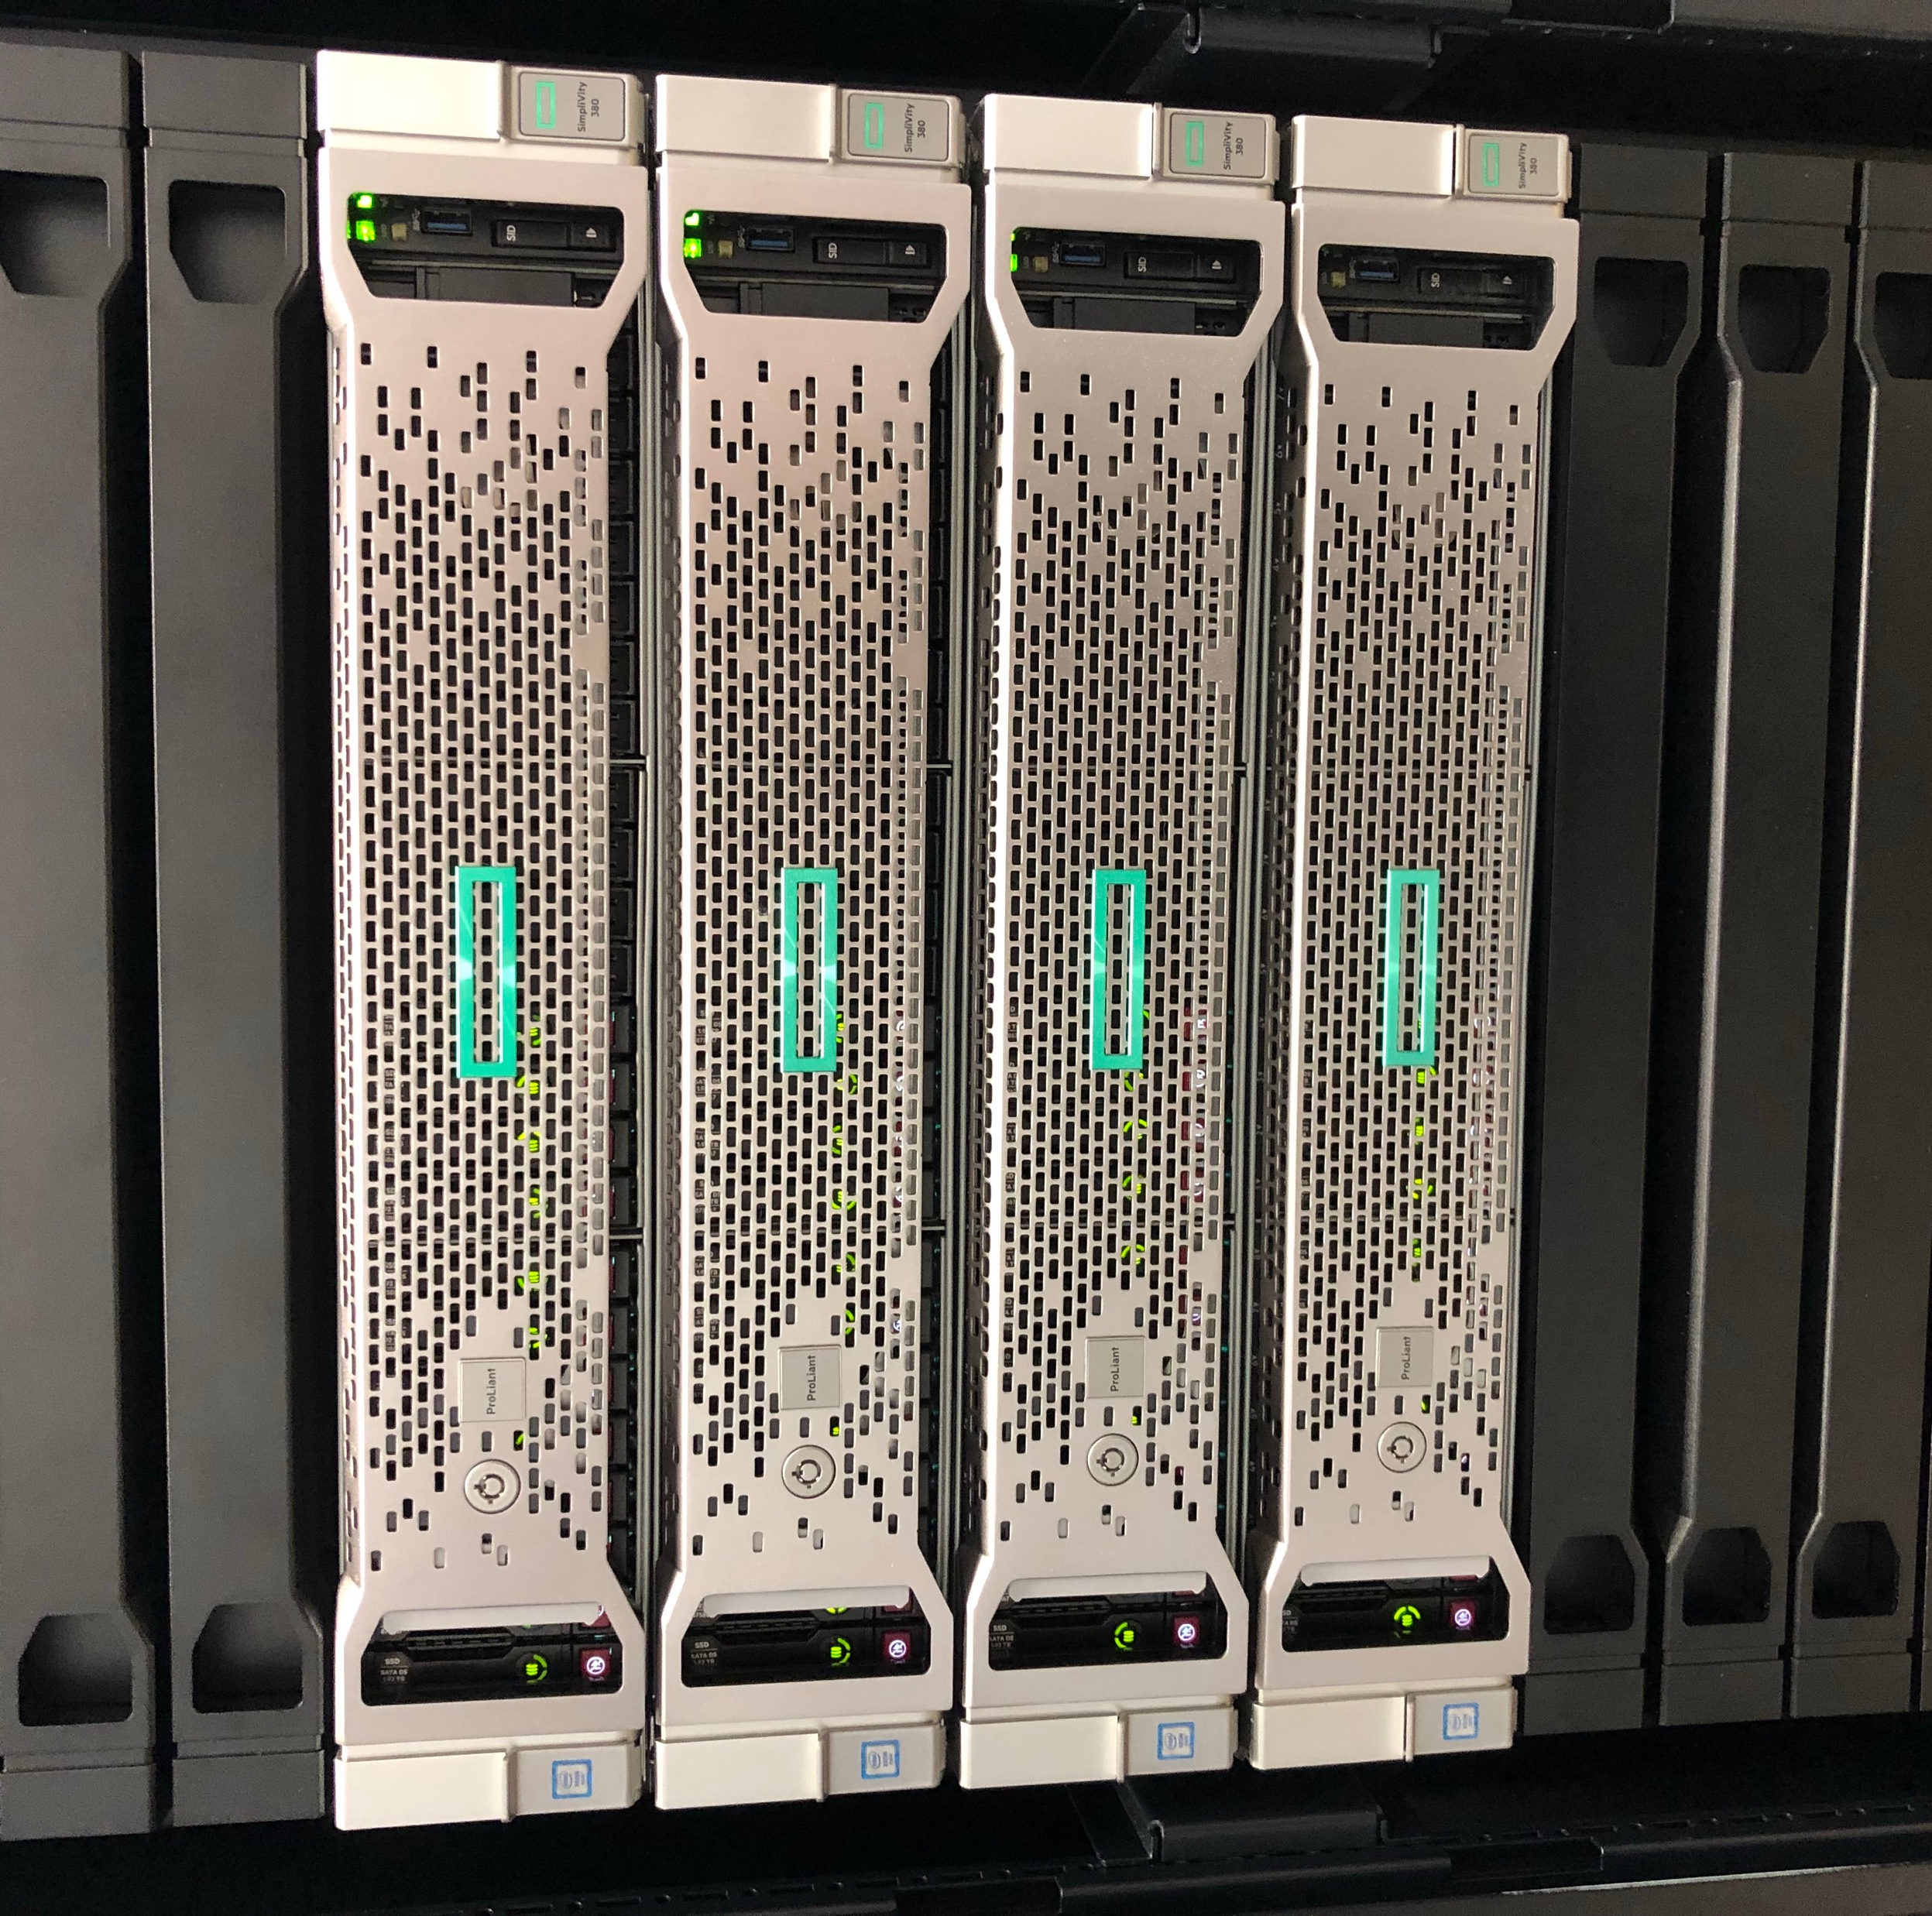
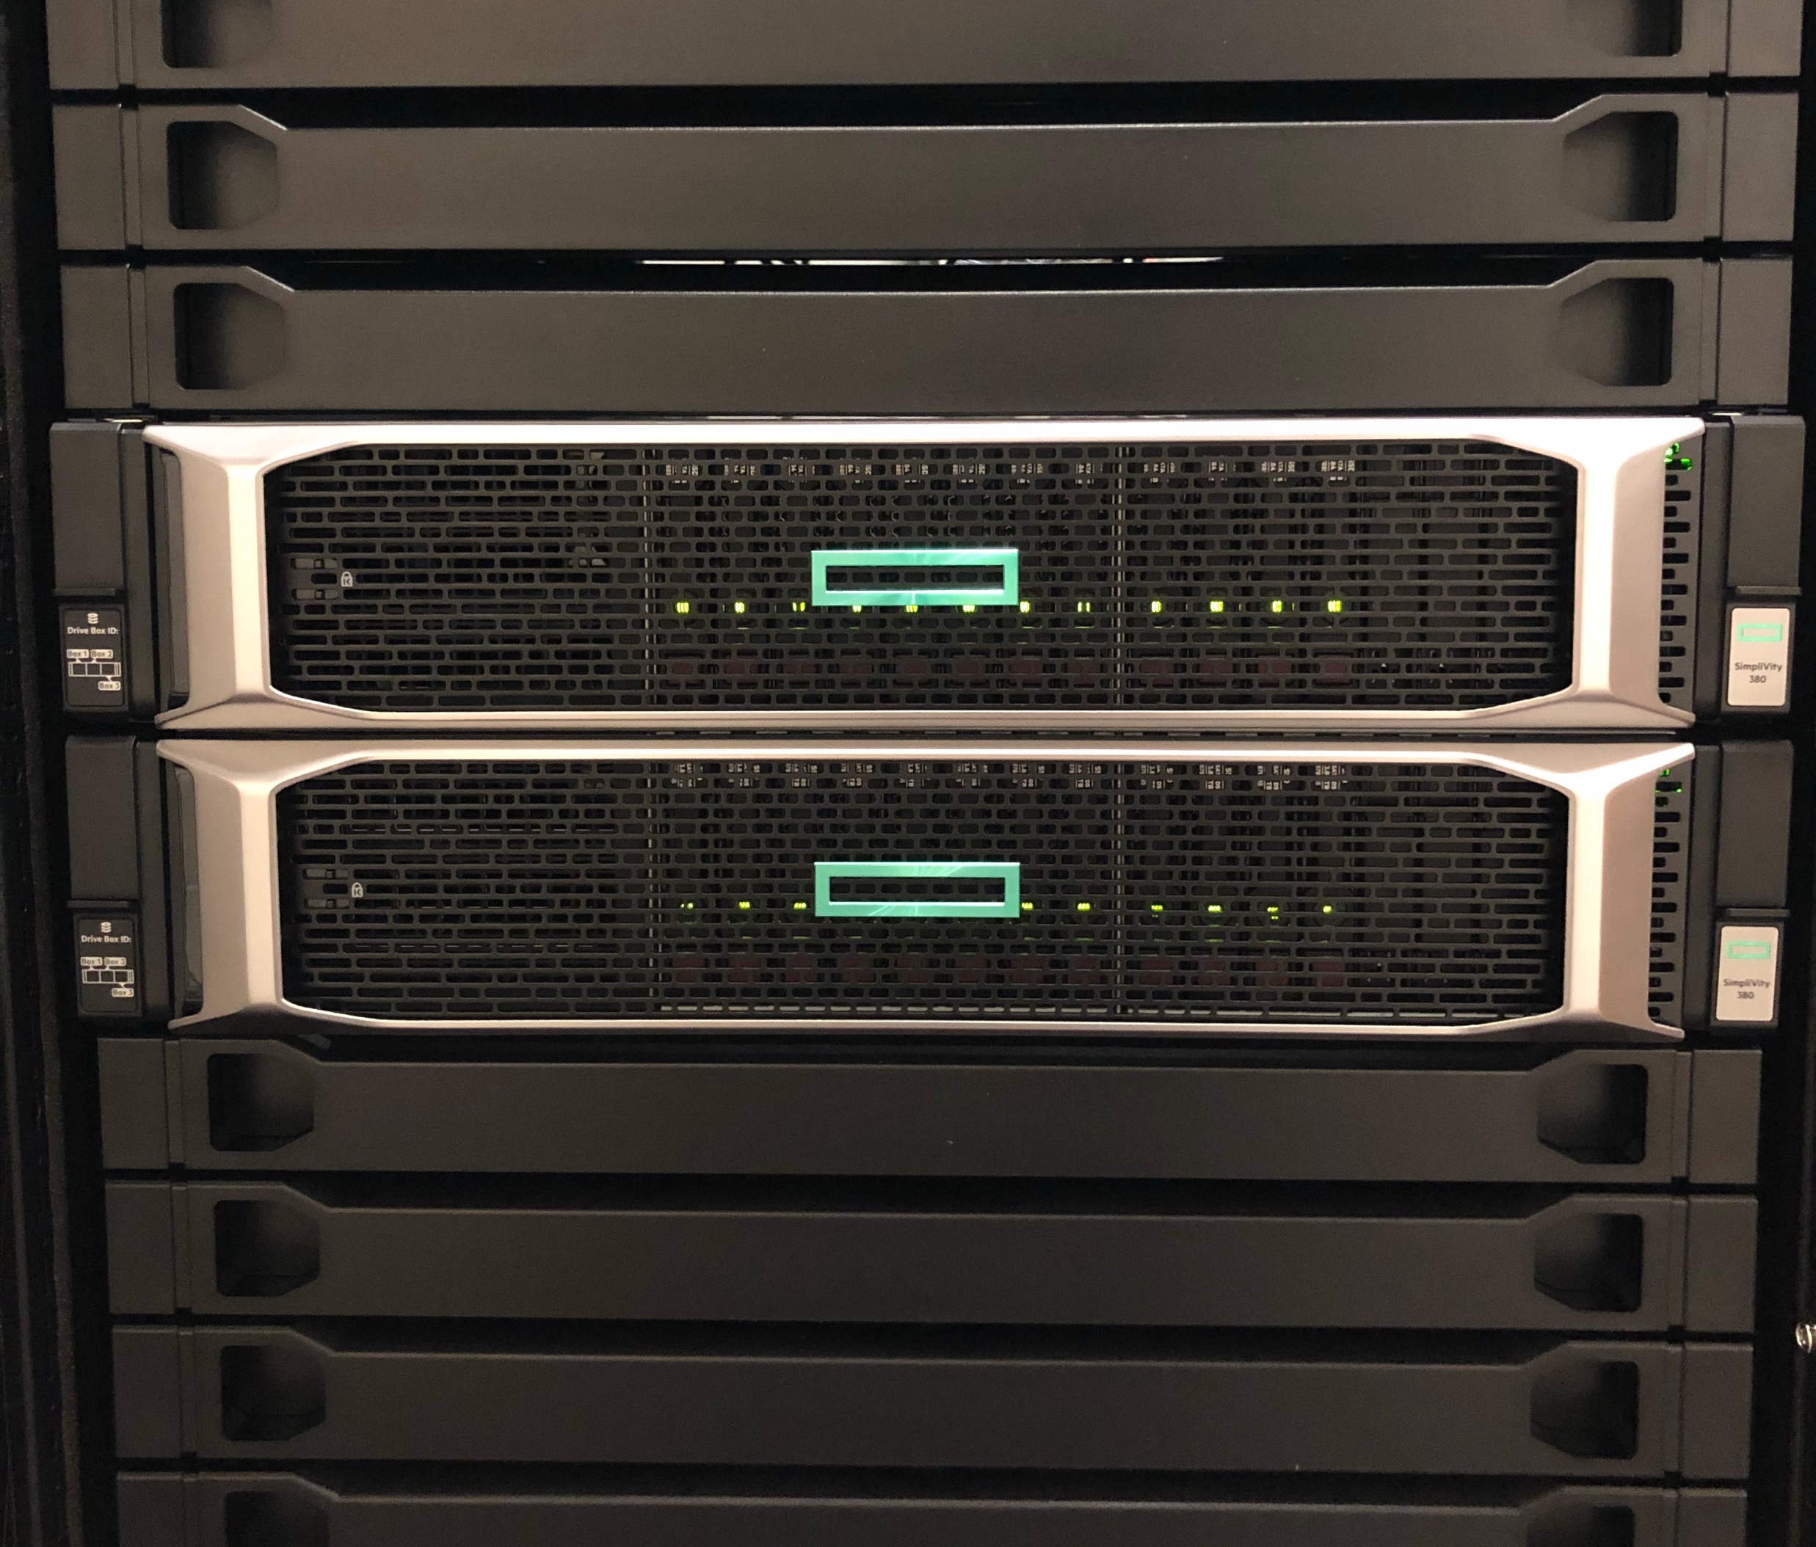
SDJ solution
Phase 1 – Production
Phase 2 – Disaster Recovery
4x HPE SimpliVity 380 Gen9 Large nodes
~100 VMs, including SQL, file servers, BMC, ClassLink, PaperCut, SCCM, and websites
Data protection has far exceeded expectations
2x HPE SimpliVity 380 Gen10 X-Large nodes
All VMs backed up to DR site
Capacity to run only most critical VMs
  If complete site loss, additional nodes will be acquired
  Rack and switches already configured with complete capacity to handle full production load

Slide 4
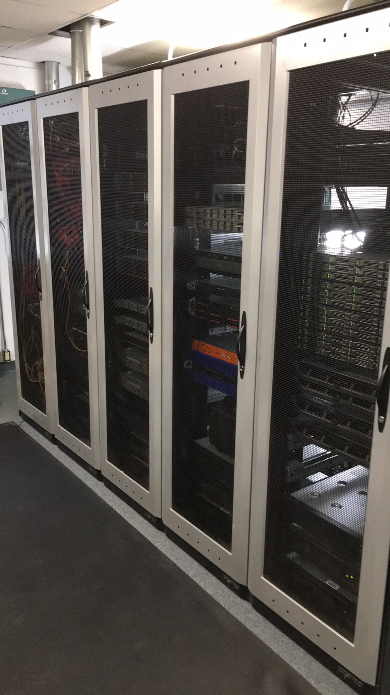
MCPASD started with…
Issues/Struggles
Traditional Server & SAN setup
SAN Hardware was no longer available
Production & DR sites
Backup window not long enough
WAN Replication buffering issues

Slide 5
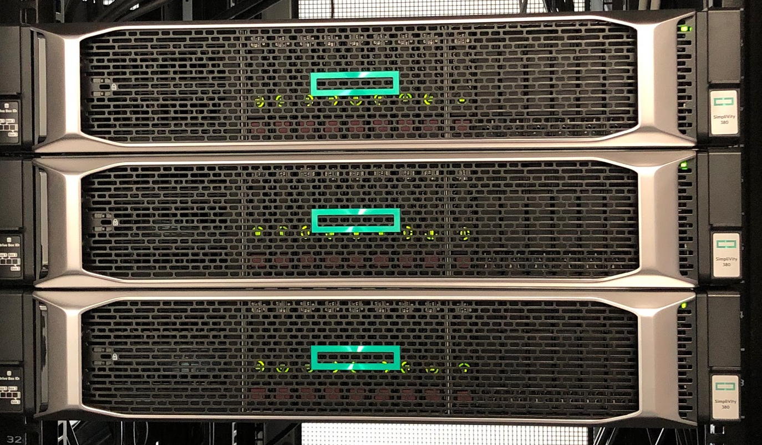
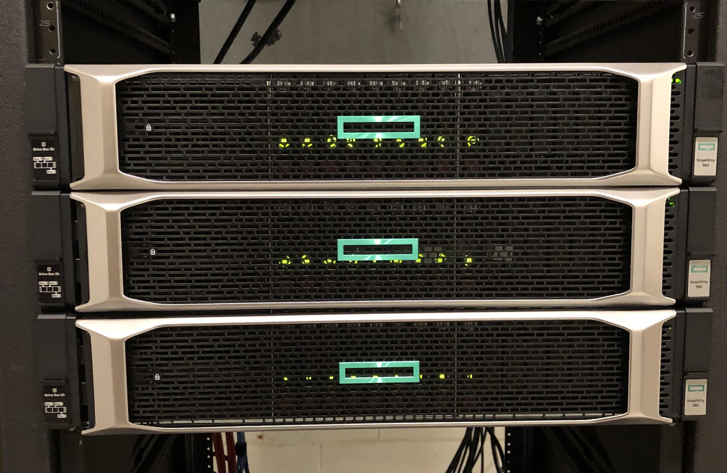
MCPASD solution
DSC Site
3x HPE SimpliVity 380 Gen10 Large nodes
100 VMs, including file servers, Skyward, Cisco VMs, Equitrac, Destiny, SQL, ZCM
All VMs backed up locally and to MHS Site
MHS Site
3x HPE SimpliVity 380 Gen10 Large nodes
All VMs backed up locally and to DSC Site
Capacity to run all VMs in either datacenter

Slide 6
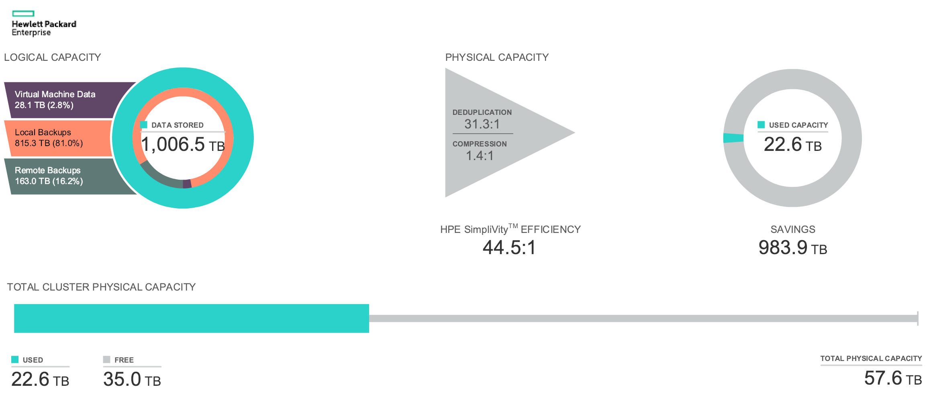
SDJ Data Efficiency

Slide 7
SDJ results
Massive consolidation: Replaced an entire rack with 8U
Simplified operations; IT staff are now able to focus on strategic tasks to assist education
Major storage capacity savings; 1006.5 TB of logical data consumes 22.6 TB of disk space
Rapid and efficient data protection; backup and recovery in minutes compared to hours
VMs reboot in seconds
Significantly fewer help desk tickets

Slide 8
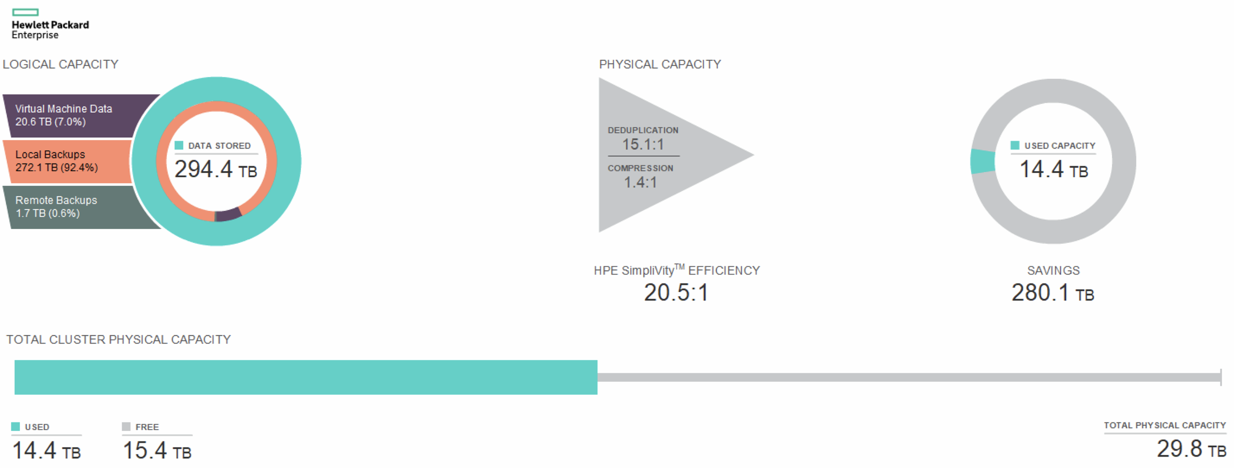
MCPASD Data Efficiency

Slide 9
MCPASD results
Simplified operations; “snap-ins” allow storage tasks to be performed within VCenter (single interface)
Resiliency and Flexibility; non-disruptive backup, recovery in minutes compared to hours
Major storage capacity savings; 579 TB of logical data consumes less than 28 TB of disk space
Consolidation: Replaced 28U with 12U

Slide 10


“SimpliVity brings a simple solution that has all of the pieces, all of the components, all of the tools, and all of the management aspects that we need in a way that we can sustain it over time.”
School District of Janesville Video Case Study
“We’ve gone from nail-biting while waiting for something to reboot, to an instant, stress-free fix”
School District of Janesville Upshot Article

Slide 11
Q&A
Feel Free to ask anything!!

Slide 12
Thank you
Cassandra Anderson
cassandra.anderson@janesville.k12.wi.us
Heikki Heikkinen
hheikkinen@mcpasd.k12.wi.us

